Slide 1
Retrieval Evaluation
Hongning Wang
CS@UVa

Slide 2


What we have learned so far
Indexed corpus
Crawler
Ranking procedure
Research attention
Feedback
Evaluation
Doc Analyzer
(Query)
User
Query Rep
Doc Rep (Index)
Ranker
Indexer
results
Index

Slide 3
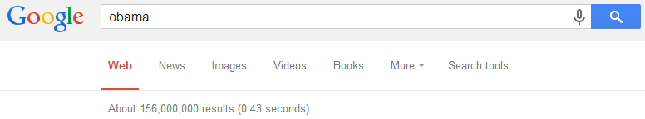

Which search engine do you prefer: Bing or Google?
What are your judging criteria?
How fast does it response to your query?
How many documents can it return?

Slide 4
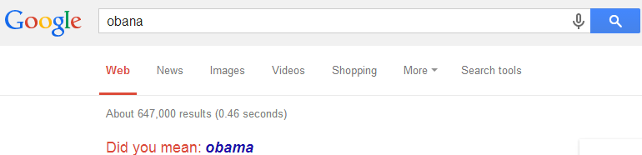
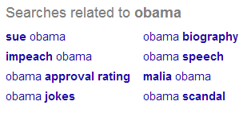
Which search engine do you prefer: Bing or Google?
What are your judging criteria?
Can it correct my spelling errors?
Can it suggest me related queries?

Slide 5
Retrieval evaluation
Aforementioned evaluation criteria are all good, but not essential
Goal of any IR system
Satisfying users’ information need
Core quality measure criterion
“how well a system meets the information needs of its users.” – wiki
Unfortunately vague and hard to execute

Slide 6
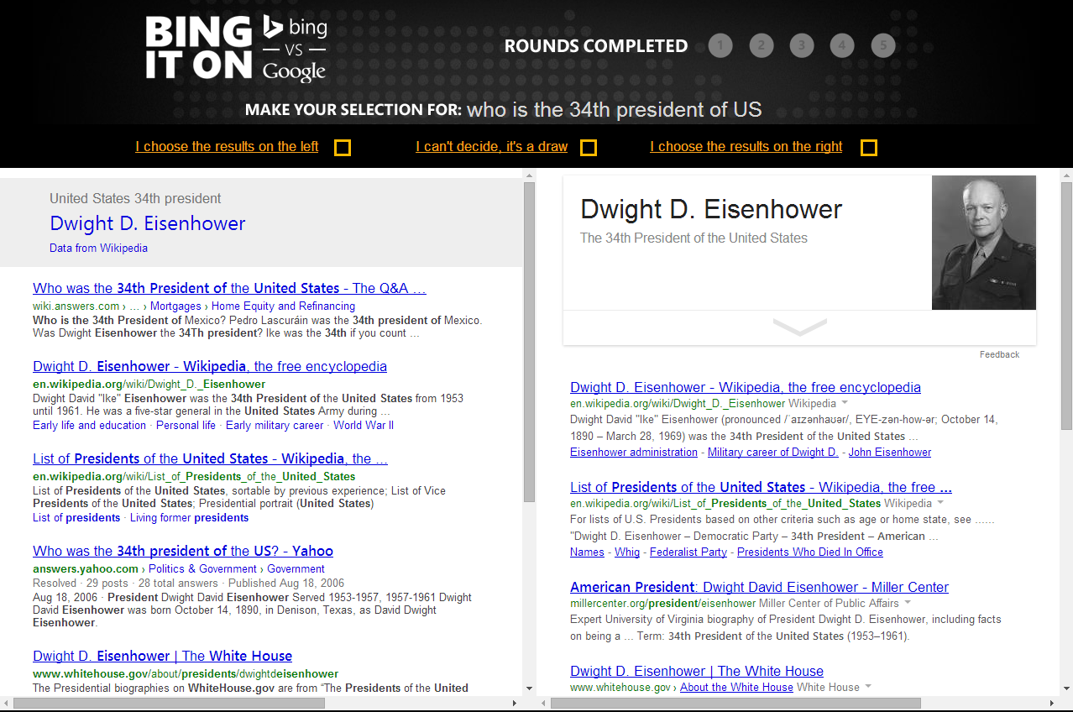
Bing v.s. Google?

Slide 7
Quantify the IR quality measure
Information need
“an individual or group's desire to locate and obtain information to satisfy a conscious or unconscious need” – wiki
Reflected by user query
Categorization of information need
Navigational
Informational
Transactional

Slide 8
Quantify the IR quality measure
Satisfaction
“the opinion of the user about a specific computer application, which they use” – wiki
Reflected by
Increased result clicks
Repeated/increased visits
Result relevance

Slide 9

Classical IR evaluation
Cranfield experiments
Pioneer work and foundation in IR evaluation
Basic hypothesis
Retrieved documents’ relevance is a good proxy of a system’s utility in satisfying users’ information need
Procedure
1,398 abstracts of aerodynamics journal articles
225 queries
Exhaustive relevance judgments of all (query, document) pairs
Compare different indexing system over such collection

Slide 10
Classical IR evaluation
Three key elements for IR evaluation
A document collection
A test suite of information needs, expressible as queries
A set of relevance judgments, e.g., binary assessment of either relevant or nonrelevant for each query-document pair

Slide 11
Search relevance
Users’ information needs are translated into queries
Relevance is judged with respect to the information need, not the query
E.g., Information need: “When should I renew my Virginia driver’s license?”
Query: “Virginia driver’s license renewal”
Judgment: whether a document contains the right answer, e.g., every 8 years; rather than if it literally contains those four words

Slide 12
Text REtrieval Conference (TREC)
Large-scale evaluation of text retrieval methodologies
Since 1992, hosted by NIST
Standard benchmark for IR studies
A wide variety of evaluation collections
Web track
Question answering track
Cross-language track
Microblog track
And more…

Slide 13
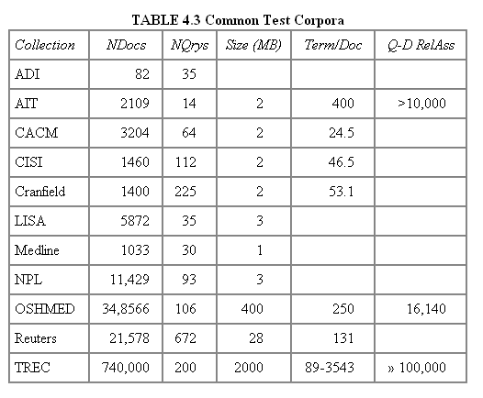
Public benchmarks
Table from Manning Stanford CS276, Lecture 8

Slide 14
Evaluation metric
To answer the questions
Is Google better than Bing?
Which smoothing method is most effective?
Is BM25 better than language models?
Shall we perform stemming or stopword removal?
We need a quantifiable metric, by which we can compare different IR systems
As unranked retrieval sets
As ranked retrieval results

Slide 15
Recap: retrieval evaluation
Aforementioned evaluation criteria are all good, but not essential
Goal of any IR system
Satisfying users’ information need
Core quality measure criterion
“how well a system meets the information needs of its users.” – wiki
Unfortunately vague and hard to execute

Slide 16
Recap: classical IR evaluation
Cranfield experiments
Pioneer work and foundation in IR evaluation
Basic hypothesis
Retrieved documents’ relevance is a good proxy of a system’s utility in satisfying users’ information need
Procedure
1,398 abstracts of aerodynamics journal articles
225 queries
Exhaustive relevance judgments of all (query, document) pairs
Compare different indexing system over such collection

Slide 17
Recap: classical IR evaluation
Three key elements for IR evaluation
A document collection
A test suite of information needs, expressible as queries
A set of relevance judgments, e.g., binary assessment of either relevant or nonrelevant for each query-document pair

Slide 18


Recap: evaluation of unranked retrieval sets
In a Boolean retrieval system
Precision: fraction of retrieved documents that are relevant, i.e., p(relevant|retrieved)
Recall: fraction of relevant documents that are retrieved, i.e., p(retrieved|relevant)
 | relevant | nonrelevant
retrieved | true positive (TP) | false positive (FP)
not retrieved | false negative (FN) | true negative (TN)
Precision:
$$P=\frac{TP}{TP+FP}$$
Recall:
$$R=\frac{TP}{TP+FN}$$

Slide 19
Evaluation of unranked retrieval sets
Precision and recall trade off against each other
Precision decreases as the number of retrieved documents increases (unless in perfect ranking), while recall keeps increasing
These two metrics emphasize different perspectives of an IR system
Precision: prefers systems retrieving fewer documents, but highly relevant
Recall: prefers systems retrieving more documents

Slide 20

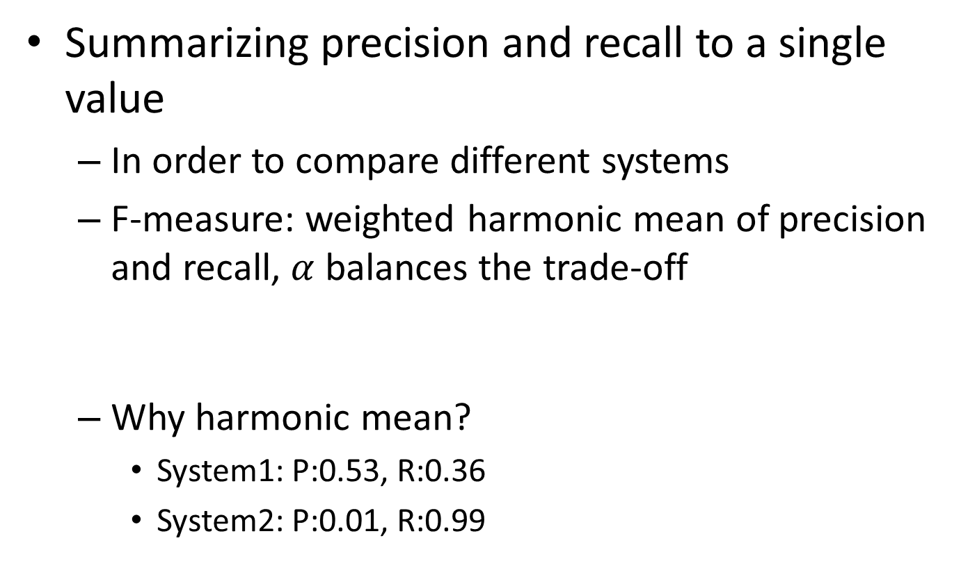

Evaluation of unranked retrieval sets
Summarizing precision and recall to a single value
In order to compare different systems
F-measure: weighted harmonic mean of precision and recall, $α$ balances the trade-off
Why harmonic mean?
System1: P:0.53, R:0.36
System2: P:0.01, R:0.99
$$F=\frac{1}{α\frac{1}{P}+\left(1−α\right)\frac{1}{R}}$$
$$\left(F_{1}=\frac{2}{\frac{1}{P}+\frac{1}{R}} \right)$$
H | A
0.429 | 0.445
0.019 | 0.500
Equal weight between precision and recall

Slide 21
Evaluation of ranked retrieval results
Ranked results are the core feature of an IR system
Precision, recall and F-measure are set-based measures, that cannot assess the ranking quality
Solution: evaluate precision at every recall point
precision
System1
System2
x
Which system is better?
x
x
x
x
x
x
x
x
recall
x

Slide 22
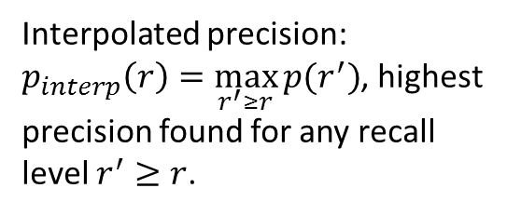
Precision-Recall curve
A sawtooth shape curve
Interpolated precision: $p_{interp}\left(r\right)=\max_{r^{′}≥r}{p(r^{′})}$, highest precision found for any recall level $r^{′}≥r$.

Slide 23
Evaluation of ranked retrieval results
Summarize the ranking performance with a single number
Binary relevance
Eleven-point interpolated average precision
Precision@K (P@K)
Mean Average Precision (MAP)
Mean Reciprocal Rank (MRR)
Multiple grades of relevance
Normalized Discounted Cumulative Gain (NDCG)

Slide 24
Eleven-point interpolated average precision
At the 11 recall levels [0,0.1,0.2,…,1.0], compute arithmetic mean of interpolated precision over all the queries

Slide 25

Precision@K
Set a ranking position threshold K
Ignores all documents ranked lower than K
Compute precision in these top K retrieved documents
E.g.,:
P@3 of 2/3
P@4 of 2/4
P@5 of 3/5
In a similar fashion we have Recall@K
Relevant
Nonrelevant

Slide 26
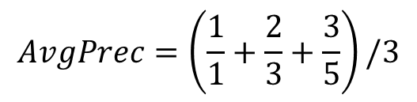
Mean Average Precision
Consider rank position of each relevant doc
E.g.,K₁, K₂, … K_{R}
Compute P@K for each K₁, K₂, … K_{R}
Average precision = average of those P@K
E.g.,
MAP is mean of Average Precision across multiple queries/rankings
$$AvgPrec=\left(\frac{1}{1}+\frac{2}{3}+\frac{3}{5}\right)/3$$

Slide 27
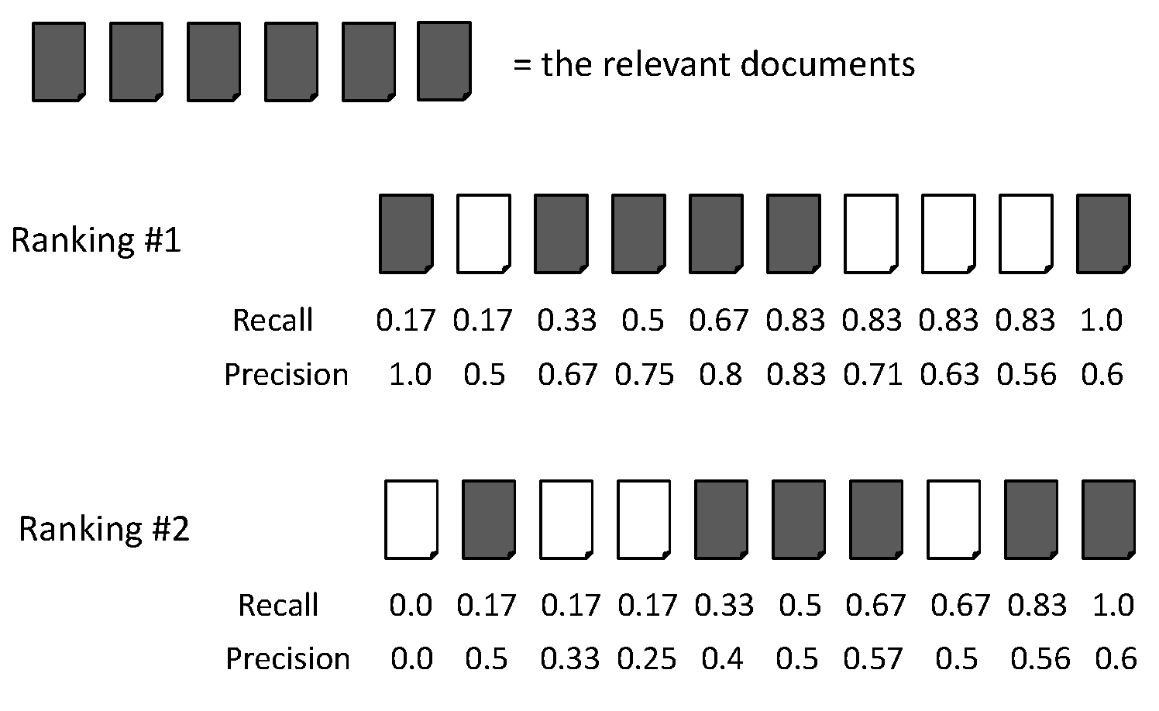
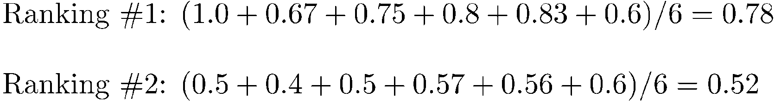
AvgPrec is about one query
AvgPrec of the two rankings
Figure from Manning Stanford CS276, Lecture 8

Slide 28
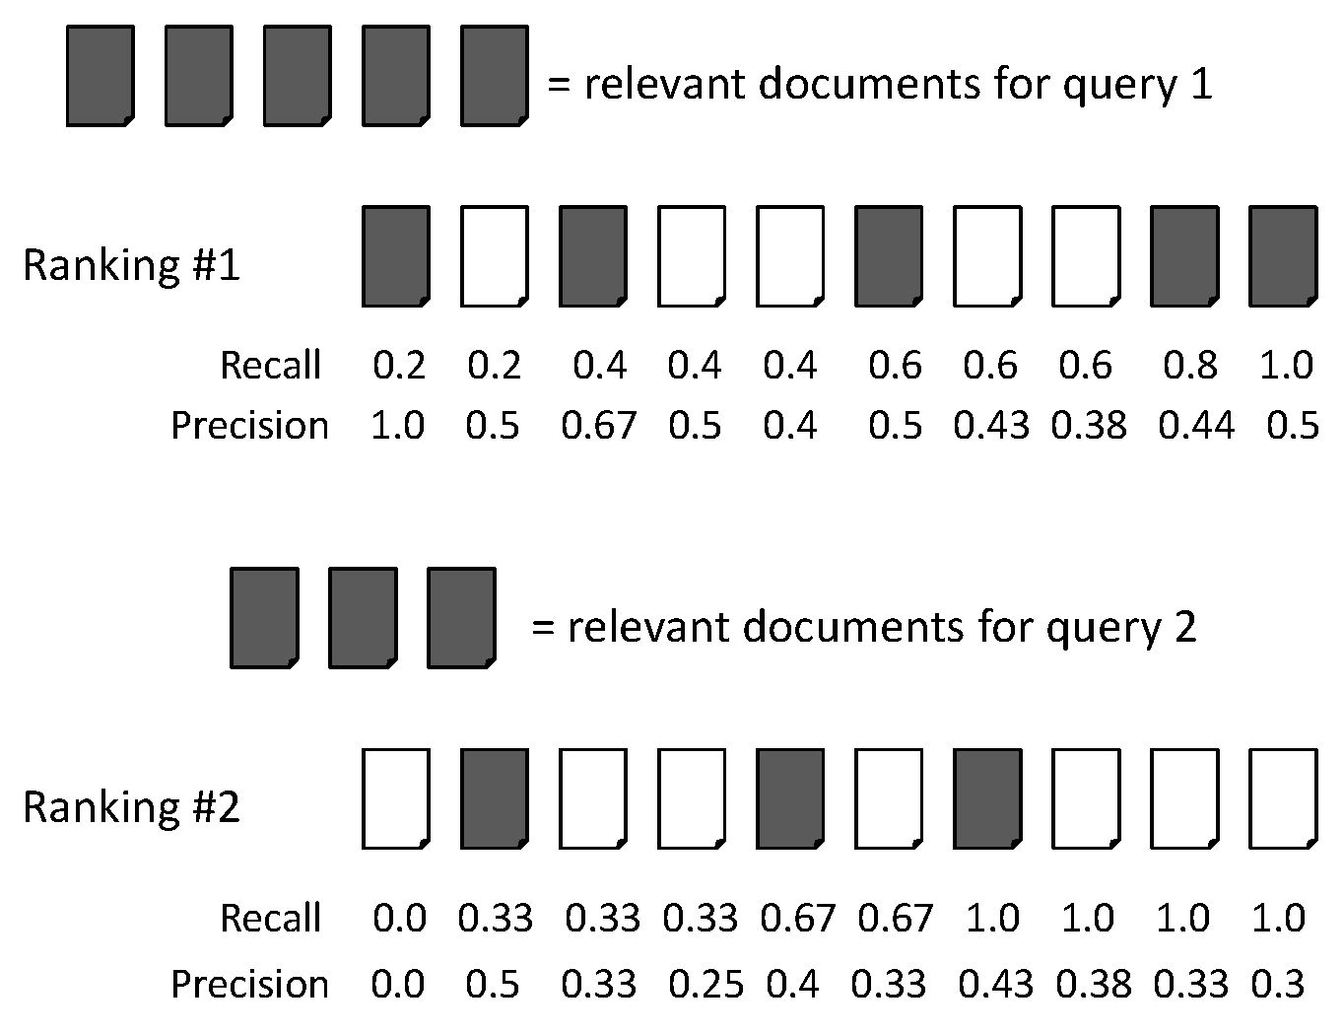
MAP is about a system
Figure from Manning Stanford CS276, Lecture 8
Query 1, AvgPrec=(1.0+0.67+0.5+0.44+0.5)/5=0.62
Query 2, AvgPrec=(0.5+0.4+0.43)/3=0.44
MAP = (0.62+0.44)/2=0.53

Slide 29
MAP metric
If a relevant document never gets retrieved, we assume the precision corresponding to that relevant document to be zero
MAP is macro-averaging: each query counts equally
MAP assumes users are interested in finding many relevant documents for each query
MAP requires many relevance judgments in text collection

Slide 30
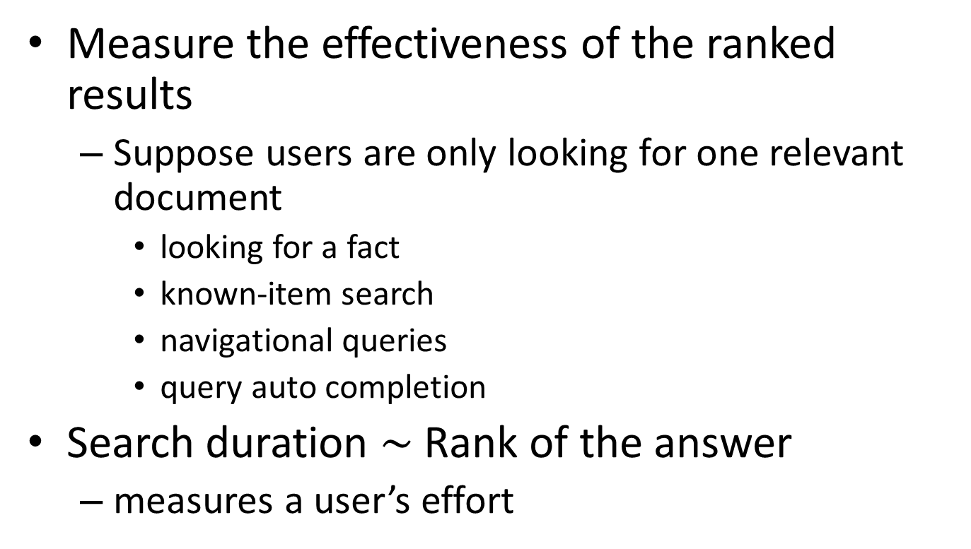
Mean Reciprocal Rank
Measure the effectiveness of the ranked results
Suppose users are only looking for one relevant document
looking for a fact
known-item search
navigational queries
query auto completion
Search duration $\sim$ Rank of the answer
measures a user’s effort

Slide 31
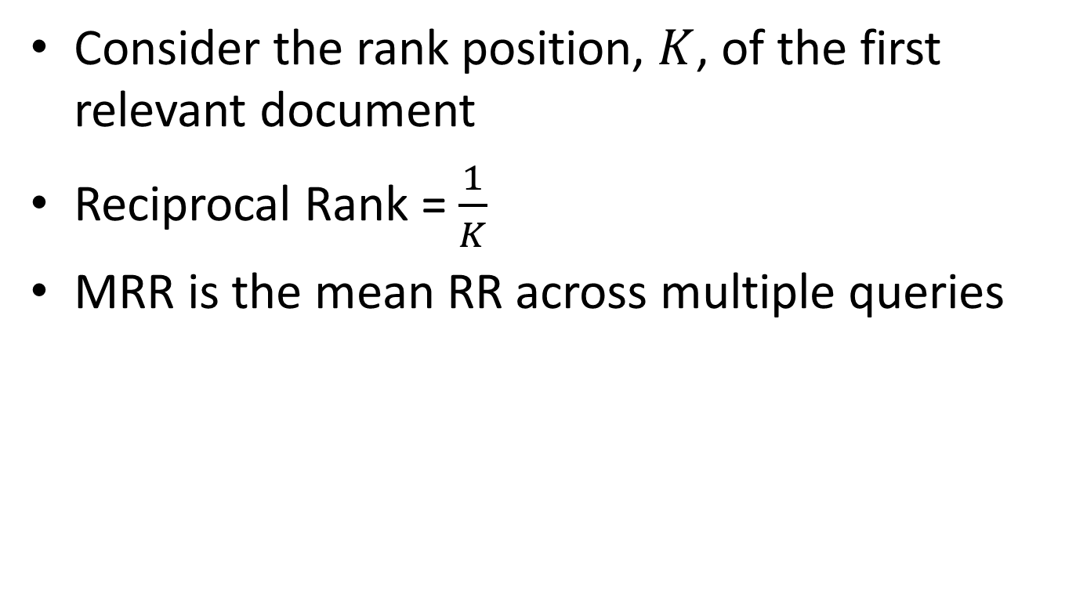
Mean Reciprocal Rank
Consider the rank position, $K$, of the first relevant document
Reciprocal Rank = $\frac{1}{K}$
MRR is the mean RR across multiple queries

Slide 32
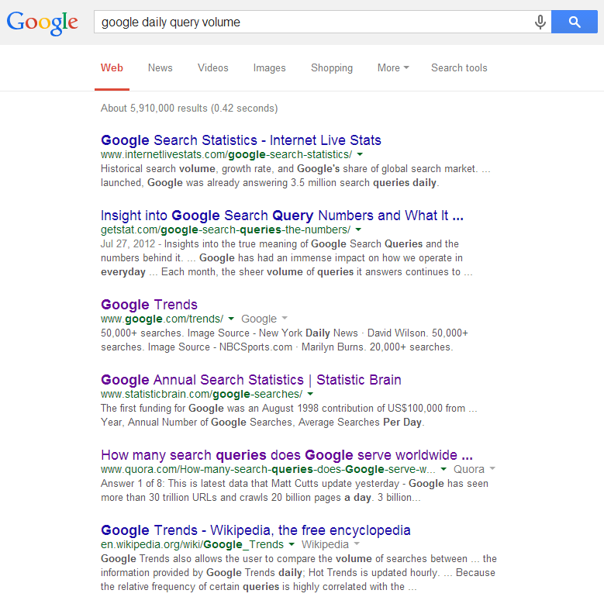
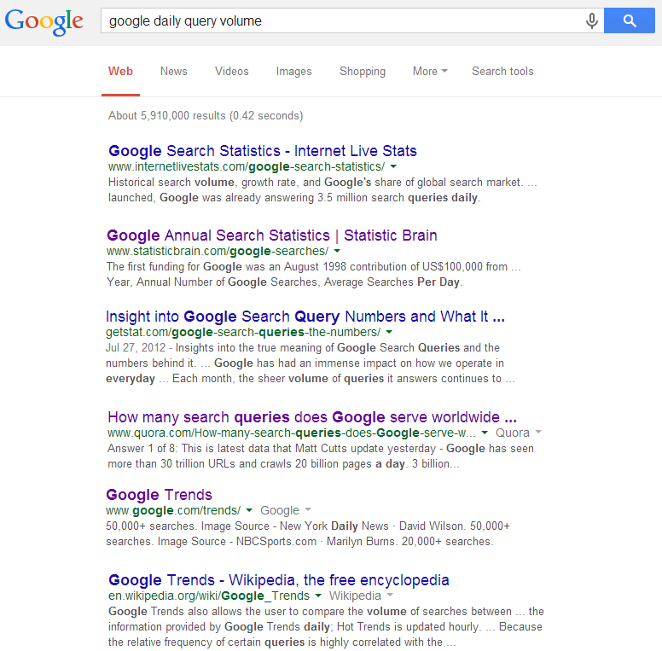
Beyond binary relevance
Excellent
Same P@6?!
Fair
Good
Same MAP?!
Fair
Relevant
Nonrelevant
Bad
Good
Fair
Fair
Bad
Bad
Bad

Slide 33
Beyond binary relevance
The level of documents’ relevance quality with respect to a given query varies
Highly relevant documents are more useful than marginally relevant documents
The lower the ranked position of a relevant document is, the less useful it is for the user, since it is less likely to be examined
Discounted Cumulative Gain

Slide 34
Discounted Cumulative Gain
Uses graded relevance as a measure of usefulness, or gain, from examining a document
Gain is accumulated starting at the top of the ranking and discounted at lower ranks
Typical discount is 1/log (rank)
With base 2, the discount at rank 4 is 1/2, and at rank 8 it is 1/3

Slide 35
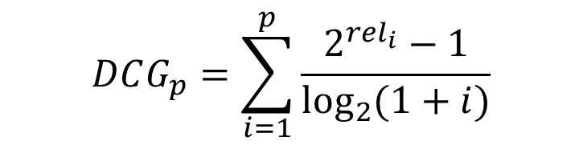
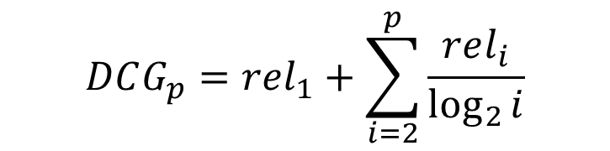
Discounted Cumulative Gain
DCG is the total gain accumulated at a particular rank position p:
Alternative formulation
Standard metric in some web search companies
Emphasize on retrieving highly relevant documents
Relevance label at position i
$$DCG_{p}=rel_{1}+\sum_{i=2}^{p}{\frac{rel_{i}}{\log_{2}{i}}}$$
$$DCG_{p}=\sum_{i=1}^{p}{\frac{2^{rel_{i}}−1}{\log_{2}{(1+i)}}}$$

Slide 36
Normalized Discounted Cumulative Gain
Normalization is useful for contrasting queries with varying numbers of relevant results
Normalize DCG at rank n by the DCG value at rank n of the ideal ranking
The ideal ranking is achieved via ranking documents with their relevance labels

Slide 37
Recap: evaluation of unranked retrieval sets
Summarizing precision and recall to a single value
In order to compare different systems
F-measure: weighted harmonic mean of precision and recall, $α$ balances the trade-off
Why harmonic mean?
System1: P:0.53, R:0.36
System2: P:0.01, R:0.99
$$F=\frac{1}{α\frac{1}{P}+\left(1−α\right)\frac{1}{R}}$$
$$\left(F_{1}=\frac{2}{\frac{1}{P}+\frac{1}{R}} \right)$$
H | A
0.429 | 0.445
0.019 | 0.500
Equal weight between precision and recall

Slide 38
Recap: evaluation of ranked retrieval results
Ranked results are the core feature of an IR system
Precision, recall and F-measure are set-based measures, that cannot assess the ranking quality
Solution: evaluate precision at every recall point
precision
System1
System2
x
Which system is better?
x
x
x
x
x
x
x
x
recall
x

Slide 39
Recap: evaluation of ranked retrieval results
Summarize the ranking performance with a single number
Binary relevance
Eleven-point interpolated average precision
Precision@K (P@K)
Mean Average Precision (MAP)
Mean Reciprocal Rank (MRR)
Multiple grades of relevance
Normalized Discounted Cumulative Gain (NDCG)

Slide 40
Recap: Precision@K
Set a ranking position threshold K
Ignores all documents ranked lower than K
Compute precision in these top K retrieved documents
E.g.,:
P@3 of 2/3
P@4 of 2/4
P@5 of 3/5
In a similar fashion we have Recall@K
Relevant
Nonrelevant

Slide 41
Recap: Mean Average Precision
Consider rank position of each relevant doc
E.g.,K₁, K₂, … K_{R}
Compute P@K for each K₁, K₂, … K_{R}
Average precision = average of those P@K
E.g.,
MAP is mean of Average Precision across multiple queries/rankings
$$AvgPrec=\left(\frac{1}{1}+\frac{2}{3}+\frac{3}{5}\right)/3$$

Slide 42
Recap: MAP is about a system
Figure from Manning Stanford CS276, Lecture 8
Query 1, AvgPrec=(1.0+0.67+0.5+0.44+0.5)/5=0.62
Query 2, AvgPrec=(0.5+0.4+0.43)/3=0.44
MAP = (0.62+0.44)/2=0.53

Slide 43
Recap: Mean Reciprocal Rank
Measure the effectiveness of the ranked results
Suppose users are only looking for one relevant document
looking for a fact
known-item search
navigational queries
query auto completion
Search duration $\sim$ Rank of the answer
measures a user’s effort

Slide 44
Recap: beyond binary relevance
Excellent
Same P@6?!
Fair
Good
Same MAP?!
Fair
Relevant
Nonrelevant
Bad
Good
Fair
Fair
Bad
Bad
Bad

Slide 45
Recap: Discounted Cumulative Gain
Uses graded relevance as a measure of usefulness, or gain, from examining a document
Gain is accumulated starting at the top of the ranking and discounted at lower ranks
Typical discount is 1/log (rank)
With base 2, the discount at rank 4 is 1/2, and at rank 8 it is 1/3

Slide 46
Recap: Discounted Cumulative Gain
DCG is the total gain accumulated at a particular rank position p:
Alternative formulation
Standard metric in some web search companies
Emphasize on retrieving highly relevant documents
Relevance label at position i
$$DCG_{p}=rel_{1}+\sum_{i=2}^{p}{\frac{rel_{i}}{\log_{2}{i}}}$$
$$DCG_{p}=\sum_{i=1}^{p}{\frac{2^{rel_{i}}−1}{\log_{2}{(1+i)}}}$$

Slide 47
Recap: Normalized Discounted Cumulative Gain
Normalization is useful for contrasting queries with varying numbers of relevant results
Normalize DCG at rank n by the DCG value at rank n of the ideal ranking
The ideal ranking is achieved via ranking documents with their relevance labels

Slide 48



NDCG - Example
How about P@4, P@5, MAP and MRR?
5 documents: d₁, d₂, d₃, d₄, d₅
i | Ground Truth |  | Ranking Function₁ |  | Ranking Function₂
 | Document Order | rel_{i} | Document Order | rel_{i} | Document Order | rel_{i}
1 | d5 | 4 | d3 | 2 | d5 | 4
2 | d4 | 3 | d4 | 3 | d3 | 2
3 | d3 | 2 | d2 | 1 | d4 | 3
4 | d2 | 1 | d5 | 4 | d1 | 0
5 | d1 | 0 | d1 | 0 | d2 | 1
 | NDCG_{GT}=1.00 |  | NDCG_{RF1}=0.67 |  | NDCG_{RF2}=0.97
$DCG_{GT}=\frac{2^{4}−1}{\log_{2}{2}}+\frac{2^{3}−1}{\log_{2}{3}}+\frac{2^{2}−1}{\log_{2}{4}}$+$\frac{2^{1}−1}{\log_{2}{5}}+\frac{2^{0}−1}{\log_{2}{6}}=21.35$
$DCG_{RF1}=\frac{2^{2}−1}{\log_{2}{2}}+\frac{2^{3}−1}{\log_{2}{3}}+\frac{2^{1}−1}{\log_{2}{4}}$+$\frac{2^{4}−1}{\log_{2}{5}}+\frac{2^{0}−1}{\log_{2}{6}}=14.38$
$DCG_{RF2}=\frac{2^{4}−1}{\log_{2}{2}}+\frac{2^{2}−1}{\log_{2}{3}}+\frac{2^{3}−1}{\log_{2}{4}}$+$\frac{2^{0}−1}{\log_{2}{5}}+\frac{2^{1}−1}{\log_{2}{6}}=20.78$

Slide 49
What does query averaging hide?
Figure from Doug Oard’s presentation, originally from Ellen Voorhees’ presentation

Slide 50
Statistical significance tests
How confident you are that an observed difference doesn’t simply result from the particular queries you chose?
Experiment 1
Experiment 2
Query
System A
System B
Query
System A
System B
1
2
3
4
5
6
7
0.20
0.21
0.22
0.19
0.17
0.20
0.21
0.40
0.41
0.42
0.39
0.37
0.40
0.41
11
12
13
14
15
16
17
0.02
0.39
0.26
0.38
0.14
0.09
0.12
0.76
0.07
0.17
0.31
0.02
0.91
0.56
Average
0.20
0.40
Average
0.20
0.40

Slide 51
Background knowledge
p-value in statistic test is the probability of obtaining data as extreme as was observed, if the null hypothesis were true (e.g., if observation is totally random)
If p-value is smaller than the chosen significance level (α), we reject the null hypothesis (e.g., observation is not random)
We seek to reject the null hypothesis (we seek to show that the observation is a random result), and so small p-values are good
51

Slide 52
Tests usually used in IR evaluations
Sign test
Hypothesis: the difference median is zero between samples from two continuous distributions
Wilcoxon signed rank test
Hypothesis: data are paired and come from the same population
Paired t-test
Hypothesis: difference between two responses measured on the same statistical unit has a zero mean value
One-tail v.s. two-tail?
If you aren’t sure, use two-tail

Slide 53
Statistical significance testing
Query
System A
System B
Sign Test
paired t-test
1
2
3
4
5
6
7
0.02
0.39
0.26
0.38
0.14
0.09
0.12
0.76
0.07
0.17
0.31
0.02
0.91
0.56
+
-
-
-
-
+
+
+0.74
-0.32
-0.09
-0.07
-0.12
+0.82
+0.44
Average
0.20
0.40
p=0.9375
p=0.2927
95% of outcomes
0

Slide 54
Where do we get the relevance labels?
Human annotation
Domain experts, who have better understanding of retrieval tasks
Scenario 1: annotator lists the information needs, formalizes into queries, and judges the returned documents
Scenario 2: given query and associated documents, annotator judges the relevance by inferring the underlying information need

Slide 55
Assessor consistency
Is inconsistency of assessors a concern?
Human annotators are idiosyncratic and variable
Relevance judgments are subjective
Studies mostly concluded that the inconsistency didn’t affect relative comparison of systems
Success of an IR system depends on how good it is at satisfying the needs of these idiosyncratic humans
Lesk & Salton (1968): assessors mostly disagree on documents at lower ranks, but measures are more affected by top-ranked documents

Slide 56

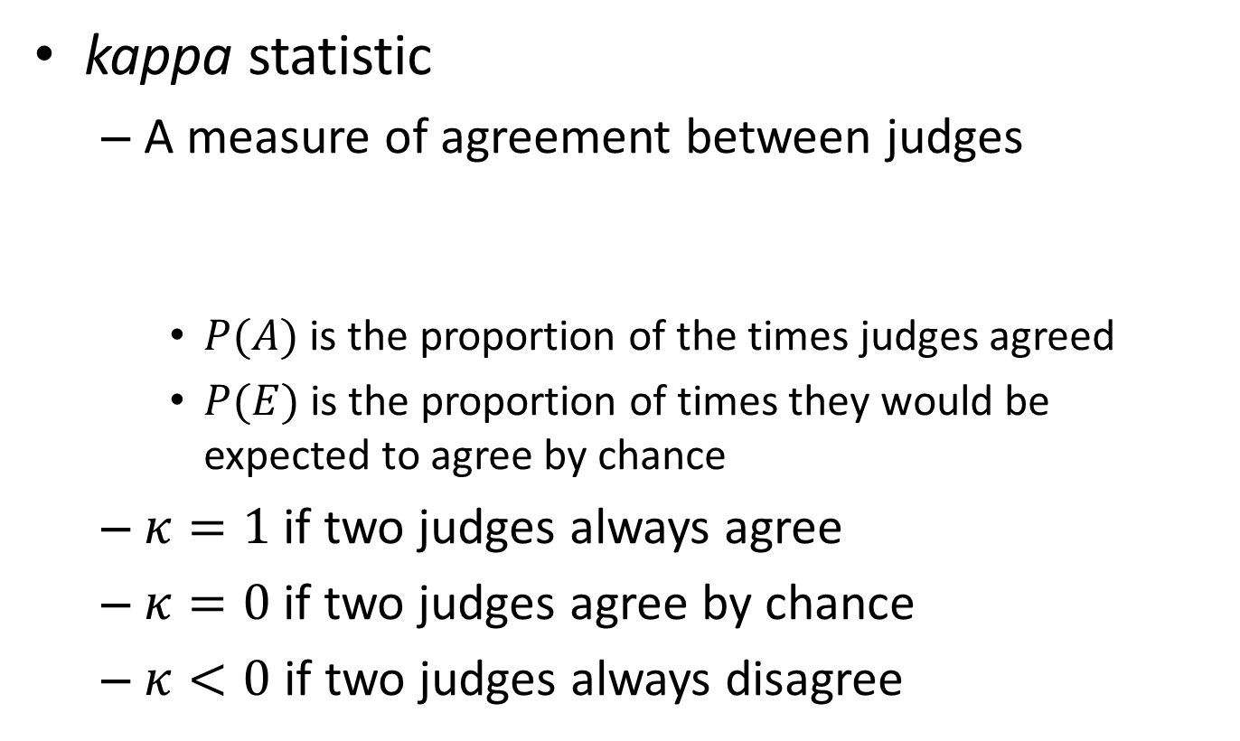
Measuring assessor consistency
kappa statistic
A measure of agreement between judges
$P(A)$ is the proportion of the times judges agreed
$P(E)$ is the proportion of times they would be expected to agree by chance
$κ=1$ if two judges always agree
$κ=0$ if two judges agree by chance
$κ<0$ if two judges always disagree
$$κ=\frac{P\left(A\right)−P(E)}{1−P(E)}$$

Slide 57
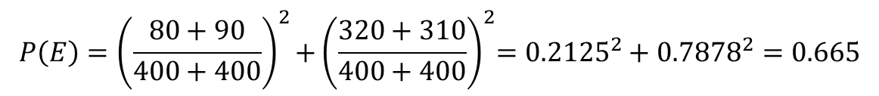
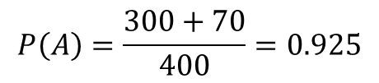
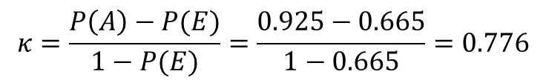
Example of kappa statistic
judge 2 relevance
 | Yes | No | Total
Yes | 300 | 20 | 320
No | 10 | 70 | 80
Total | 310 | 90 | 400
judge 1 relevance
$$P\left(A\right)=\frac{300+70}{400}=0.925$$
$$P\left(E\right)={\left(\frac{80+90}{400+400}\right)}^{2}{+\left(\frac{320+310}{400+400}\right)}^{2}={0.2125}^{2}+{0.7878}^{2}=0.665$$
$$κ=\frac{P\left(A\right)−P(E)}{1−P(E)}=\frac{0.925−0.665}{1−0.665}=0.776$$

Slide 58
Prepare annotation collection
Human annotation is expensive and time consuming
Cannot afford exhaustive annotation of large corpus
Solution: pooling
Relevance is assessed over a subset of the collection that is formed from the top k documents returned by a number of different IR systems

Slide 59
Does pooling work?
Judgments cannot possibly be exhaustive?
Relative rankings among the systems remain the same
What about documents beyond top k?
Relative rankings among the systems remain the same
A lot of research work can be done here
Effective pool construction
Depth v.s. diversity

Slide 60
Rethink retrieval evaluation
Goal of any IR system
Satisfying users’ information need
Core quality measure criterion
“how well a system meets the information needs of its users.” – wiki

Slide 61
What we have considered
The ability of the system to present all relevant documents
Recall-driven measures
The ability of the system to withhold non-relevant documents
Precision-driven measures

Slide 62
Challenging assumptions in classical IR evaluations
Assumption 1
Queries sent to an IR system would be the same as those sent to a librarian (i.e., sentence-length request), and users want to have high recall
Assumption 2
Relevance = independent topical relevance
Documents are independently judged, and then ranked (that is how we get the ideal ranking)

Slide 63
What we have not considered
The physical form of the output
User interface
The effort, intellectual or physical, demanded of the user
User effort when using the system
Bias IR research towards optimizing relevance-centric metrics

Slide 64
What you should know
Core criterion for IR evaluation
Basic components in IR evaluation
Classical IR metrics
Statistical test
Annotator agreement

Slide 65
Today’s reading
Introduction to information retrieval
Chapter 8: Evaluation in information retrieval

